Slide 1
Comparison of Classical approach and Deep Learning approach for Financial Studies using SPSS and Python.
Presented by :
Sagnik Ghosh (21375049)
Susanta Dhurua (21375062)

Slide 2
Introduction.
Adani Green Energy Limited (AGEL) is a renewable energy company based in India. It is a part of the Adani Group, one of India's largest conglomerates. AGEL is primarily focused on developing, building, and operating renewable power plants in India and around the world.
Here are some key details about Adani Green Energy:
Ownership: AGEL is majority-owned by Adani Enterprises Limited, which holds a 74.92% stake in the company. The remaining shares are held by public investors.
Business segments: AGEL operates in two main business segments: Solar Energy and Wind Energy. It also has a small presence in other renewable energy technologies such as biomass and small hydro.
Capacity: As of September 2021, AGEL has an installed renewable energy capacity of over 25 GW, making it one of the largest renewable energy companies in the world. Its capacity includes both operational and under-construction projects.
Financials: AGEL reported a consolidated revenue of INR 2,867 crore (US$384 million) in Q1 FY22, up 28% from the same period in the previous year. Its net profit for the same period was INR 219 crore (US$29 million).

Slide 3
Relevant stock variables
Open : The open price in stock refers to the price at which a particular stock begins trading at the beginning of a trading session, such as the opening of the stock market for the day.
Close: The closing price in stock refers to the final price at which a particular stock trades on a particular trading day. It is the last price at which a trade was executed before the market closes for the day.
Adjusted_close: The Adjusted Close price in stock refers to the final price at which a particular stock trades on a specific trading day, but with adjustments made for any corporate actions that may have affected the stock's price, such as stock splits, dividends, or mergers.
Volume: Volume in stock refers to the total number of shares of a particular stock that have been traded during a specific period of time, typically a trading day.

Slide 4
Importance of Closing Price.
The closing price in stock is an important metric that provides crucial information for investors and traders to make decisions about buying or selling a stock. It helps in price discovery, daily performance tracking, technical analysis, and understanding market sentiment.
Here are some of the reasons =>
Price Discovery: It helps investors and traders to know the fair value of the stock at the end of the trading day, and to use this information to make informed decisions about buying or selling the stock.
Daily Performance: The closing price is also used to calculate the daily performance of a stock, which is an important metric for investors to track the gains or losses made on their investments.
Technical Analysis: The closing price is an important input for technical analysts who use historical price charts to identify trends and patterns in the stock market.
Market Sentiment: A higher closing price indicates bullish sentiment, while a lower closing price indicates bearish sentiment.

Slide 5
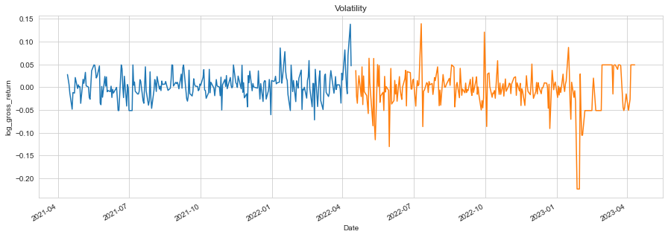
Risk Analysis.
For Time Period : 12-04-2021 to 12-04-2022 The % Volatility is : 44.21073993622326
For Time Period : 12-04-2022 to 12-04-2023 The % Volatility is : 67.10698853871095

Slide 6
ARIMA (p, d, q)
ARIMA (Autoregressive Integrated Moving Average) is a statistical model used to analyze time series data. It combines three elements: auto regression (AR), differencing (I), and moving average (MA).
Auto regression refers to the idea that a variable is regressed on its own previous values. Differencing is the process of taking the difference between consecutive observations to remove any trends or seasonality in the data. Finally, moving average refers to using the average of past errors to make predictions for the future.
The ARIMA model can be used to forecast future values of a time series based on its past behavior. It is widely used in finance, economics, and other fields where data is collected over time.
p determines the number of autoregressive (AR) terms
d determines the order of differencing
q determines the number of moving average (MA) terms

Slide 7
Classical Approach
A stationary time series is easier to analyze and model, and its statistical properties can be estimated more accurately. This is because stationary data does not exhibit random or unpredictable changes over time, which makes it possible to use past observations to make reliable predictions about future values.
Stationarity in time series refers to a property where the statistical properties of a time series (such as mean, variance, and autocorrelation) remain constant over time. In other words, the data points in a stationary time series exhibit consistent patterns and behavior throughout the entire series, without any significant trend, seasonality, or other time-dependent effects.
Test of Stationarity:
Adfuller test statistic: -1.6771510741751743
p-value: 0.44292170672527176

Slide 8
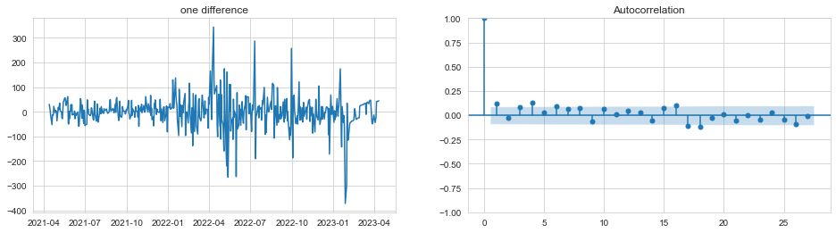
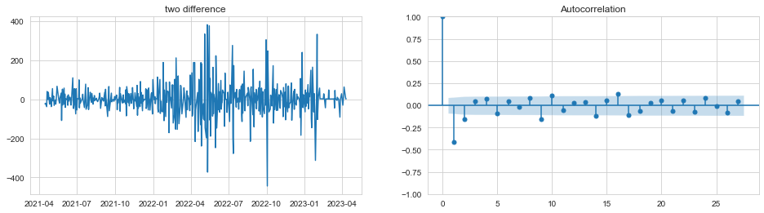
Estimation of “d” in ARIMA

Slide 9
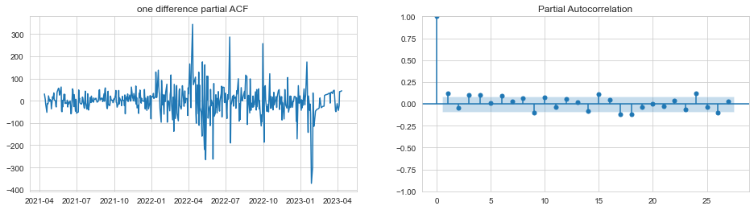
Estimation of “p” in ARIMA

Slide 10
Estimation of “q” in ARIMA

Slide 11
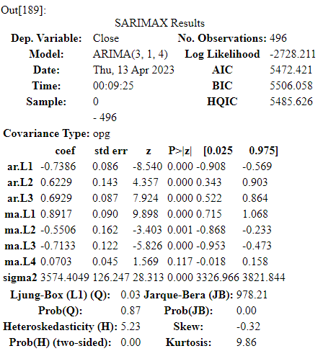
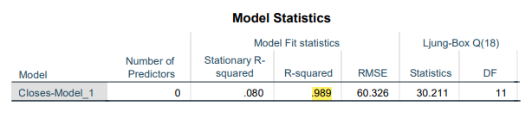
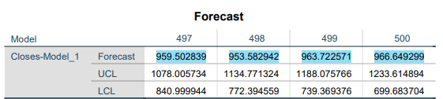
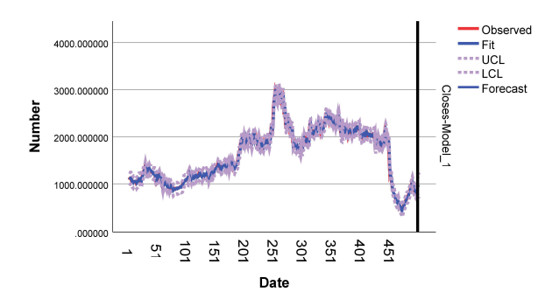
Considering the whole data of closing price as training set

Slide 12
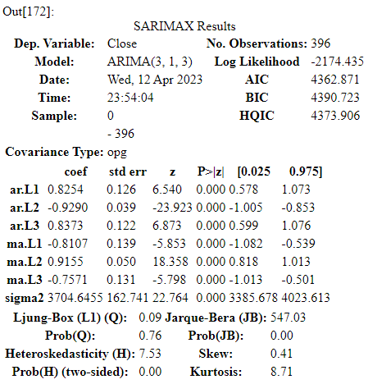
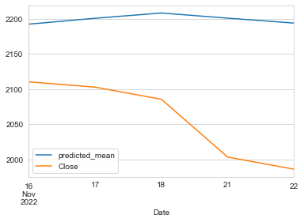
Considering 80% of the observation in training set.
The RMSE value = 154.38771800357043

Slide 13
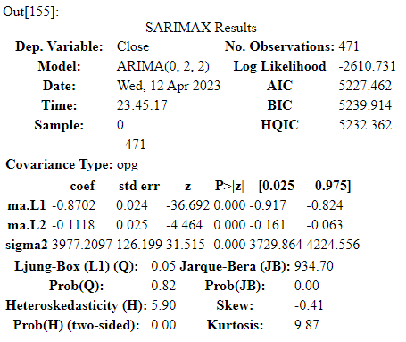
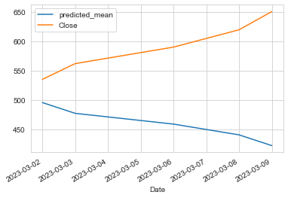
Considering 95% of the observation in training set
The RMSE value = 148.05511829577938

Slide 14
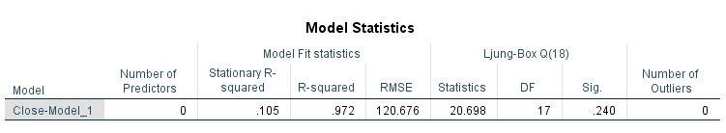
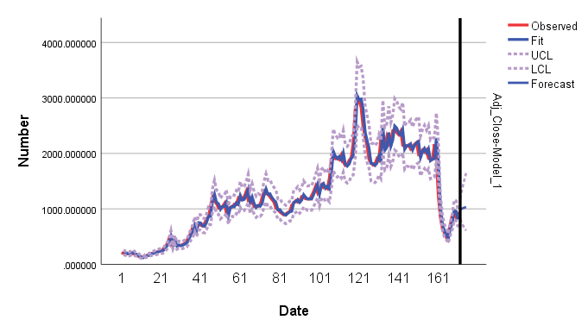
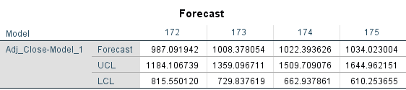
Considering weekly close price using Expert Modeler

Slide 15
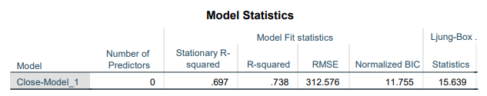

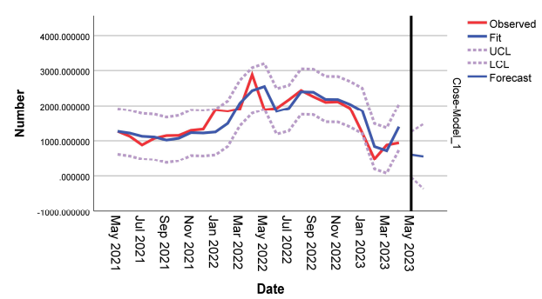
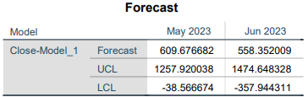
Considering monthly close price using Expert Modeler

Slide 16
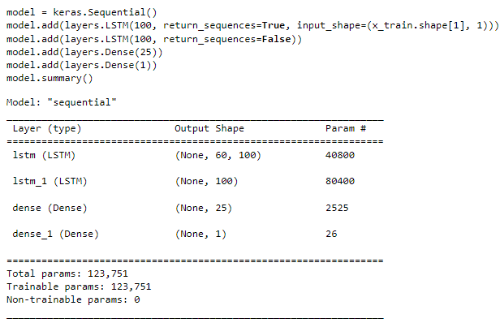
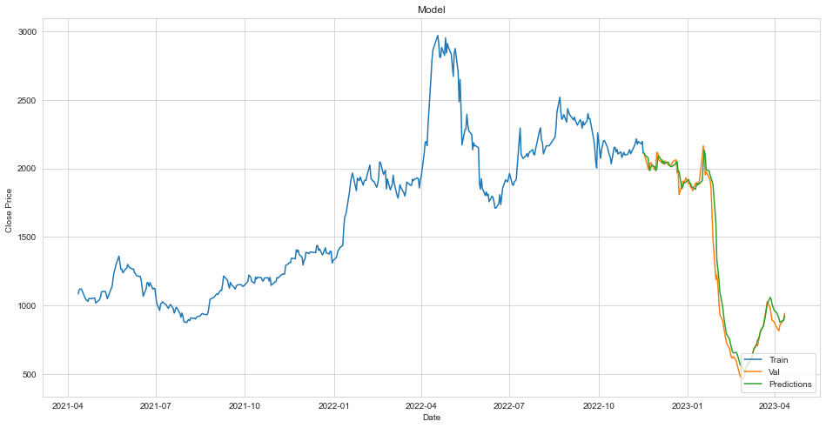
Deep Learning Approach (LSTM) using day-wise closing price.
The RMSE value = 32.395354288667946

Slide 17
Models
Time | Model | RMSE
Daily (Considering whole data) | ARIMA(3,1,4) | 60.326
Daily ( considering 80% data) | ARIMA(3,1,3) | 154.38771800357043
Daily (considering 95% data) | ARIMA(0,2,2) | 148.05511829577938
Weekly (considering whole data) | ARIMA(1,1,0) | 120.676
Monthly (considering whole data) | Simple Seasonal | 312.576
LSTM (for day-wise data) | LSTM | 32.395354288667946

Slide 18
Comparison of Classical and Deep learning approach through this analysis
LSTM (Long Short-Term Memory) and ARIMA (AutoRegressive Integrated Moving Average) are both popular models used in time series forecasting.
ARIMA is a statistical model that can be used to predict future values of a time series based on its past values. It models the data as a linear combination of its past values and the past errors. ARIMA models are well-suited for modeling stationary time series data with linear dependencies.
LSTM, on the other hand, is a type of recurrent neural network that can learn long-term dependencies in time series data. Unlike ARIMA, LSTM can handle non-linear dependencies and can capture complex patterns in the data. LSTM models are particularly useful when the data has non-linear trends or seasonality.
One advantage of ARIMA is that it is easy to interpret and understand the underlying parameters. It also works well with relatively small amounts of data. However, it requires that the data be stationary, and it may not perform well when the data has complex patterns.
LSTM typically requires a large amount of data for training, particularly for capturing long-term dependencies.
LSTM models have shown to perform well on complex time series data and can outperform ARIMA in certain cases.

Slide 19

Thank You

